Slide 1

QEHB Quarterly Complaints
PATIENT RELATIONS – UNIVERSITY HOSPITALS BIRMINGHAM
Update

Slide 2
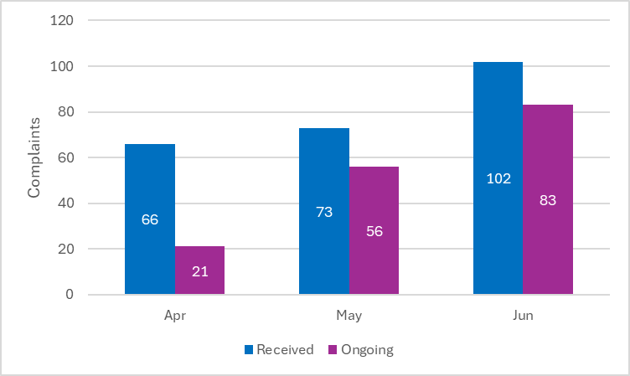
1. Complaints Received vs Ongoing Q1
🔹 Key Insights:
There is a consistent upward trend in both complaints received and those still open, with June showing a significant spike due to the large number of complaints received trustwide.
NB: The implementation of the tiered response rates from 1 June 2025 is expected to accelerate case closures in June and beyond, helping to manage the rising volume more effectively. However, it will cause a short-term overlap with the ongoing 65 w/d cases resulting in a high volume of cases due in quick succession.
Monthly Item Tracking Summary (April–June)
April: 66 items received, 21 still open
May: 73 items received (+11% from April), 56 still open
June: 102 items received (+40% from May), 83 still open

Slide 3
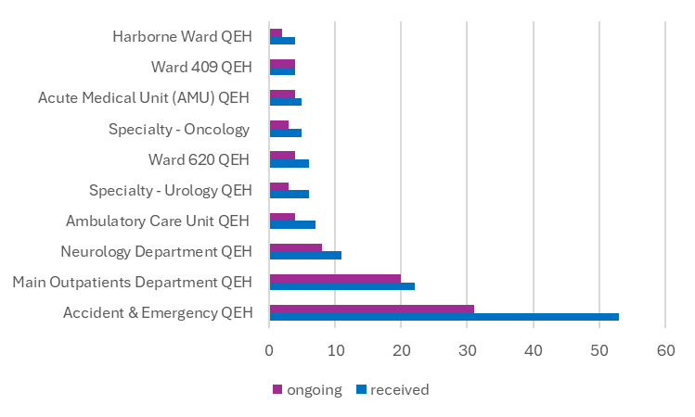
2. Top 10 Locations – Received vs Ongoing
🔹 Key Insights:
Accident & Emergency and Main Outpatients are the top contributors to complaints as is consistent with previous reports and is to be expected from high activity areas.
Item Status by Department
Accident & Emergency leads with the highest number of received complaints, making it a key focus area for improvement and resolution efforts.
Main Outpatients shows a high ongoing-to-received ratio (20 out of 22), while Neurology also reflects a similar pattern, with 8 of 11 complaints still open.
Smaller departments like Ward 409 and AMU show a 1:1 ratio, indicating potential delays in closure despite lower volumes.

Slide 4
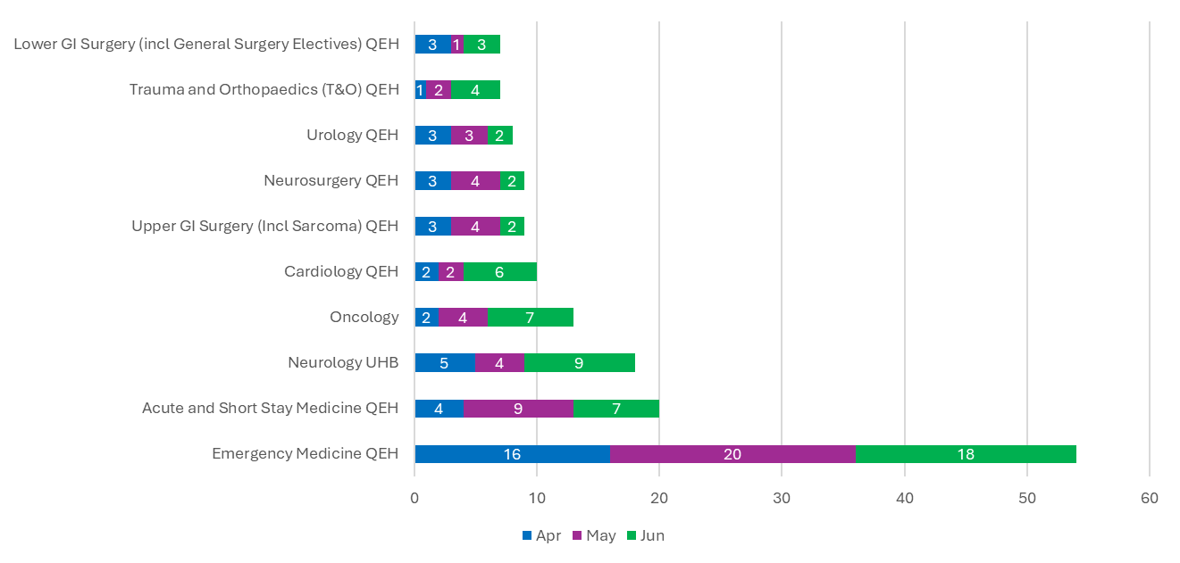
3. Top 10 Specialities – Monthly Intake
🔹 Key Insights:
Emergency Medicine consistently receives the highest number of complaints across all months, indicating sustained pressure and a need for targeted improvement.
Meanwhile, Neurology, Oncology, and Cardiology show upward trends, especially in June, indicating emerging areas of concern.
Monthly Departmental Intake:
Emergency Medicine consistently had the highest complaints across the quarter, peaking in May and remaining high in June.
Neurology showed a steady increase across the quarter, indicating a growing concern.
Most other specialities remained relatively stable, though Oncology, Cardiology, and Trauma & Orthopaedics saw noticeable increases in June.

Slide 5
4. Top 5 Complaints Subjects
🔹 Key Insights:
Clinical Treatment is the dominant theme, making up nearly half of all complaints, highlighting a critical area for quality improvement.
Communication, Patient Care, and Staff-related issues also contribute significantly, pointing to the need for a holistic approach to improving both clinical and interpersonal aspects of care.
Issue Categories Breakdown:
Clinical Treatment dominates at 49%, making it the most reported issue.
Communication follows at 16%, showing ongoing concerns with patient interactions.
Patient Care and Staff-related issues are close behind at 12% and 11%.
Admissions, Discharges, and Transfers are minimal at 3%, but still relevant.

Slide 6
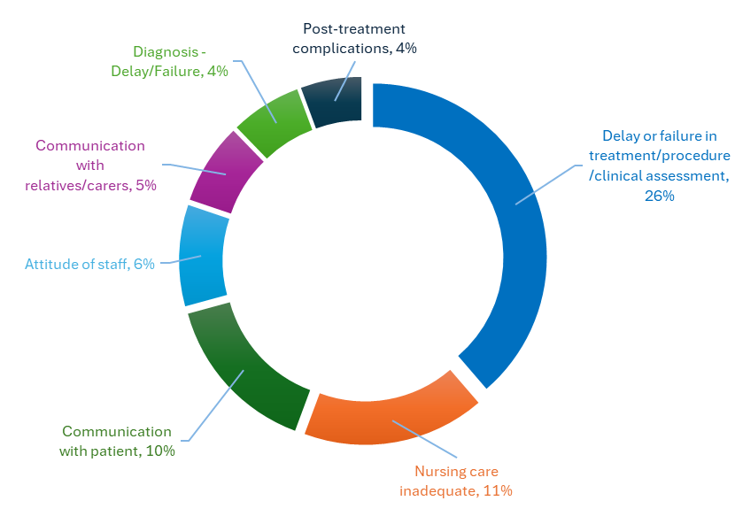
5. Top 8 complaints sub-subjects
🔹 Key Insight:
Delays or failures in treatment and clinical assessment are the most common sub-subject, highlighting a critical issue in timely and effective care delivery.
Other concerns like nursing care and communication with patients, also stand out.
Issue Distribution Overview
Treatment delays or failures lead at 26%
Nursing care and communication with patients follow at 11% and 10% respectively
Staff attitude, communication with relatives, post-treatment complications, and diagnosis delays are lower but still notable.

Slide 7
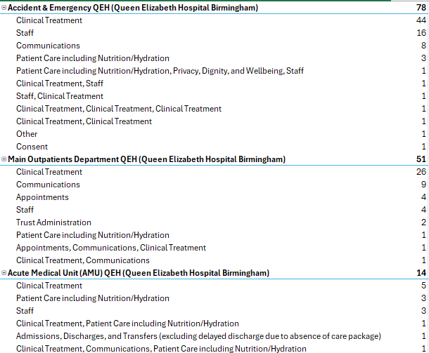
6. Top subjects for top 3 areas

Slide 8
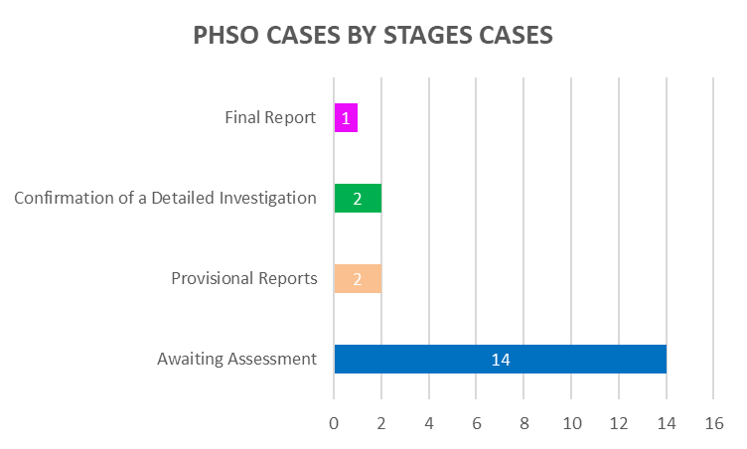

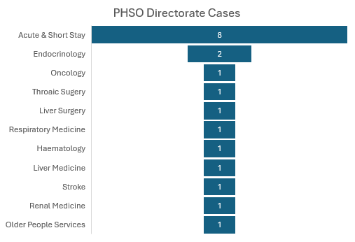
7. QEHB PHSO cases -2025/2026
Key Issues Identified by PHSO:
  📄 Documentation - Missing/inadequate records
  ⏰ Timely Communication - Delays in patient/family contact
  🧻 Continence Needs - Insufficient personal care support affecting patient dignity
  ⚕️ Pain Assessment & Management - Concerns about effective pain control and monitoring
  🩹 Pressure Ulcer Management – Inadequate prevention or treatment
Financial Remedy by Site | Amount Paid
QEHB | £1,050

Slide 9
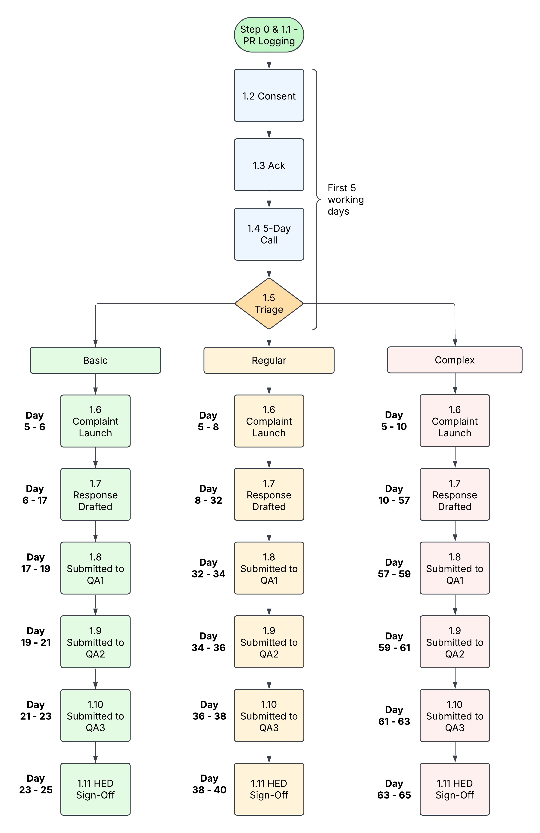
8a. For information – Tiered response rate - Process

Slide 10
8b. For information – Tiered response rate - Process
Complexity Indicator | Score
Involves multiple specialities | +1
Involves multiple sites | +1
Involves multiple CDGs | +1
Raises concern about serious clinical harm | +1
Requires input from Legal, risk, safeguarding, and vulnerabilities | +1
Suggests potential for systemic failure or trustwide learning | +1
Includes three or more separate issues | +1
Involved vulnerable groups | +1
Previously reopened or escalated complaint | +1
Total Score | Tier | Definition
0 | Early De-escalation | No real complexity, suitable for early de-escalation.
1– 2 | Basic | Straightforward issue with minimal complexity, single team involved, low risk.
3 – 4 | Regular | Most complaints. Moderate complexity, some investigations needed, may span teams/services.
5 + | Complex | High-level complaints require coordination across multiple services, high scrutiny, or risk.

Slide 11
9. Performance overview – Trustwide to March ‘25

Slide 12
10. Performance overview – Most recent DoN’s

Slide 13
11. Performance overview

Slide 14
12. Oldest Cases

Slide 15
12. Thank you – Q&A/feedback
If anyone would be interested in joining a Trustwide complaints learning actions and quality improvement group, please contact Richard.Lodder@uhb.nhs.uk or complaints@uhb.nhs.uk
If you would like to book either Investigating Complaints or The Complaints Progress training for you or your teams, please contact complaints@uhb.nhs.uk

